Slide 1
CENTERSTONE SCHOOL-BASED CLINICAL TRAINING SERIES
Relationship Building
Schools · Families · Teams
School-Based Therapist Training
Centerstone
June 2026

Slide 2
Relationship Building
Welcome to Today's Training
In this session we will focus on how intentional, consistent relationships support effective clinical work, reduce barriers to care, and strengthen outcomes across school, family, and team systems.
This training includes interactive reflection and discussion activities, followed by a research-informed overview designed to serve as a takeaway and reference after the session.
Objectives — By the end of this training you will be able to:
Recognize the role of relationship building as a foundational clinical skill in school-based therapy.
Identify key practices that strengthen relationships with schools, parents and caregivers, and teammates.
Reflect on how first impressions, consistency, boundaries, and follow-through impact trust across systems.
Practice perspective-taking and relational decision-making through guided activities.
Identify at least one intentional relational practice to apply in their current role.

Slide 3
Why This Training Matters
Relationship building is central to effective school-based therapy. How therapists engage with schools, families, and colleagues directly affects trust, access to care, engagement, and follow-through. Strong relationships reduce friction, support collaboration, and create the conditions necessary for meaningful clinical work.
This training emphasizes intentional, consistent relational practices that support both client outcomes and therapist sustainability. By strengthening how we show up within systems, we improve not only individual relationships, but the effectiveness of the program as a whole.
How you show up in systems determines what is possible within them.

Slide 4
Three Equally Important Relationship Domains
Purpose of this training: relationship building is foundational to effective school-based therapy.
1
2
3
1 · Schools
2 · Parents and Caregivers
3 · Your Team
Establishing credibility, collaboration, and trust with counselors, administrators, and school staff. Your presence in the building determines what doors open for your clients.
Building rapport, engagement, and partnership without over-focusing on administrative processes. Families are essential partners — not just signatories.
Fostering trust, psychological safety, and shared ownership within your clinical and administrative teams. The relationships behind the scenes shape everything in front of clients.
All three domains are interdependent. Strength in one supports the others.

Slide 5
The Foundation
First impressions matter — People form impressions quickly based on tone, presence, authenticity, and professionalism. Be intentional from the very first interaction.
Consistency builds trust — Reliability over time is more impactful than intensity upfront. Show up the same way, every time.
CORE PRINCIPLES
Curiosity over assumptions — Seeking to understand perspectives strengthens collaboration and reduces defensiveness. Ask before you conclude.
What Every Strong Relationship Requires
Boundaries create safety — Clear, respectful boundaries support sustainable relationships — for you and for everyone you serve.
These principles apply regardless of who you are engaging — school, family, or team.
Repair is part of relationship — Missteps happen. Owning and repairing them strengthens trust more than never making mistakes at all.
These are not soft skills. They are clinical competencies.

Slide 6
PART 1 · SCHOOLS
Before You Ever Meet Your School, They Are Already Forming Expectations.
This activity helps you think intentionally about how you enter a system and what actually builds trust from day one.
REFLECTION ACTIVITY
"Reflect: What impression do you want school staff to have of you as a partner — and what will you do in the first two weeks to create it?"
Relationship building begins before the first session.

Slide 7
Building Your School Relationships
Three practices that move you from presence to partnership.
Communication & Collaboration
Integration & Appreciation
—
Maintain regular, proactive communication with school counselors, administrators, and key staff.
—
Participate in school activities and traditions when appropriate.
—
Be present during parent-teacher conferences or school events when invited.
—
Share general updates about capacity and presence without violating confidentiality.
—
Express appreciation frequently and authentically.
—
Attend non-billable meetings when possible to build relational capital.
—
Small gestures and acknowledgment build goodwill and long-term trust.
—
Use school language and norms to increase alignment.
—
Increase visibility through informal interactions — staff rooms, hallways, lunch periods.
Relational capital is earned in the hallways, not just the session room.

Slide 8
What Builds Lasting Trust in Schools
Professional presence is intentional
Be deliberate about how you introduce yourself and your role. Professional appearance, tone, and approachability matter in school settings.
Create a welcoming environment
Your office communicates who you are before you say a word. Make it warm, professional, and reflective of your work.
PART 1 · SCHOOLS
First Impressions and Being Seen
Consistency matters more than intensity
Some schools carry skepticism based on past experiences with providers. Consistent follow-through over time is the only thing that changes that.
Be aware of personality and communication differences
Every school has a culture. Read it, respect it, and adapt your approach without compromising your professional identity.
Relationships begin at introduction and evolve through every repeated interaction.
You are not just building relationships with individuals — you are building a reputation within a system.

Slide 9
What Meaningful Family Engagement Looks Like
Lead with relationship, not paperwork
The first interaction with a caregiver shapes everything that follows. Introduce yourself as a partner in their child's care — not a service provider checking boxes.
Involve families in the clinical work
Call parents with the client present to celebrate progress, share what you are working on, and assign simple homework. Family involvement consistently predicts stronger outcomes.
Meet caregivers where they are
Flexibility in communication — timing, format, language — signals respect. Not every family can engage the same way. That is not disengagement; it is context.
PART 2 · FAMILIES
Follow through, every time
Parents and Caregivers
Caregivers remember what you promised and whether you delivered. Reliability builds trust faster than any single conversation.
Repair matters here too
When a family feels unheard or dropped, name it and address it directly. Repaired relationships are often the strongest ones.
Building rapport, engagement, and partnership — not just administrative compliance.
Families are not a barrier to clinical work. They are part of it.

Slide 10
What Healthy Team Relationships Require
PART 3 · TEAM
Your Clinical and Administrative Team
Psychological safety is the foundation — Team members perform best when they feel safe to ask questions, name concerns, and admit uncertainty without fear of judgment. This is built through consistent, non-reactive responses over time.
Fostering trust, psychological safety, and shared ownership.
Shared ownership, not isolated accountability — When the team owns outcomes together — wins and setbacks both — collaboration strengthens and blame culture weakens. Show up for each other.
Consistency with your team lead — The same practices that build trust with schools and families build trust with leadership. Communicate proactively, follow through, and repair when needed.
Peer relationships are a clinical asset — Peer modeling, shared problem-solving, and informal consultation improve clinical skill and reduce isolation. Invest in your colleagues.
Model what you want to see — The relational climate of your team is shaped by every individual in it. What you bring into the room matters.
"The relationships behind the scenes determine everything in front of clients."

Slide 11
Guided Activity — Perspective-Taking
Relational decision-making practiced out loud.
1
2
3
SCHOOLS
FAMILIES
TEAM
Schools Scenario
Families Scenario
Team Scenario
A teacher approaches you in the hallway upset that a student who sees you is acting out in class. She wants to know what is going on. How do you respond in a way that builds the relationship and protects confidentiality?
A caregiver stops returning your calls after three sessions. You know the student needs to continue. What do you do — and what do you not do?
A colleague vents to you that they are overwhelmed and behind on notes. You have your own full caseload. How do you respond in a way that is genuine and supportive without overextending yourself?
Discuss with your group
Discuss with your group
Discuss with your group
There is no single right answer. The goal is to practice reasoning relationally — out loud, with your peers.

Slide 12
What the Research Says
Relationship building is not a soft skill — it is an evidence-based one.
WHY IT WORKS CLINICALLY
WHAT HAPPENS WITHOUT IT
Therapeutic alliance is consistently the strongest predictor of client outcomes across modalities and populations.
Therapists not embedded in school culture face access barriers, referral gaps, and low session attendance more often.
School-based therapists with strong school relationships report fewer barriers to accessing students and higher session completion rates.
Families who feel like administrative targets disengage — even when their child needs care.
Caregiver engagement is one of the most robust predictors of treatment effectiveness for children and adolescents.
Teams without psychological safety underreport struggles, avoid consultation, and accumulate risk silently.
Peer support and team cohesion are protective factors against burnout and turnover among early-career clinicians.
Clinicians lacking peer connection are significantly more likely to experience burnout within the first three years.
Every relationship you build is a clinical intervention. Treat it that way.

Slide 13
CLOSING REFLECTION
What Is One Intentional Relational Practice You Will Apply?
Before you leave today, identify one specific practice — with a school, a family, or your team — that you will do differently or more intentionally starting this week.
With a school:
With a family:
With my team:
Write it down. Share it with a colleague. Revisit it in 30 days.

Slide 14
KEY TAKEAWAYS
Relationship Building — Key Takeaways
What to carry out of this room today.
Relationships are the intervention.
First impressions are clinical moments.
Consistency matters more than intensity.
Therapeutic alliance, family engagement, and team trust are not background conditions for clinical work — they are the work.
Be intentional from the very first interaction — with schools, families, and colleagues. You do not get a second first impression.
Show up the same way, every week. Reliability over time builds trust that no single impressive moment can create.
Curiosity is a relational skill.
Repair is not failure — it is relationship.
You cannot pour from an empty relational cup.
Ask before you assume. Seek to understand before you respond. This reduces defensiveness and strengthens collaboration across every system.
Missteps happen. Naming them and addressing them directly builds more trust than avoiding them ever could.
Invest in your team relationships. Peer support and psychological safety protect you and your clients.
Centerstone Clinical Training Series · Relationship Building · June 2026

Slide 15
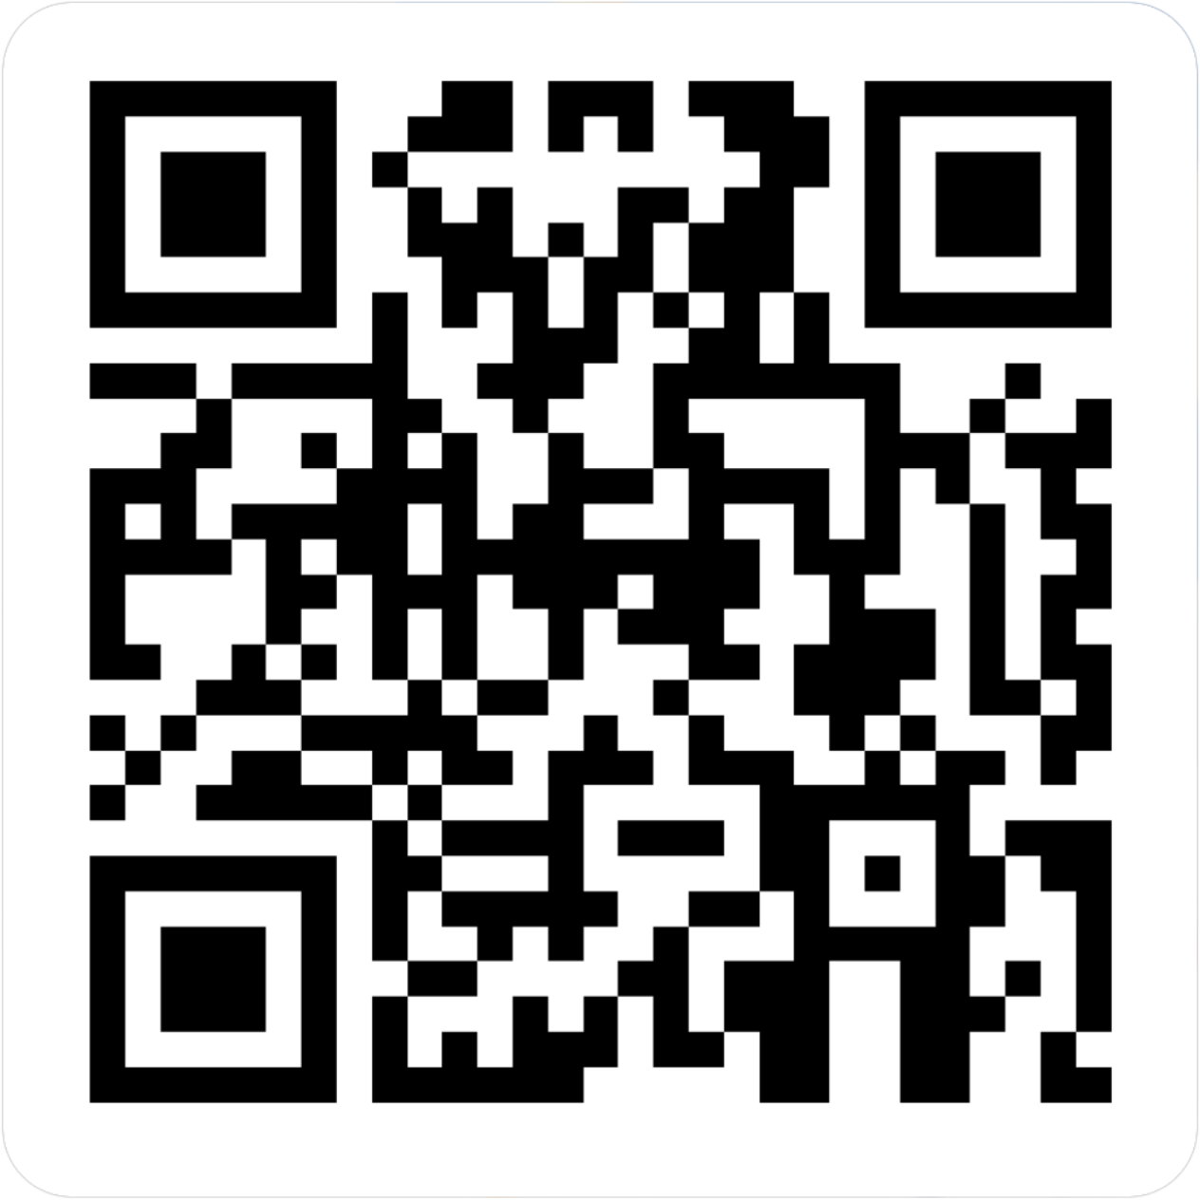
CENTERSTONE SCHOOL-BASED CLINICAL TRAINING SERIES
Relationship Building
Completion of this survey is required for attendance verification for today’s training.
https://forms.office.com/r/EXVCQtPbti

